Slide 1
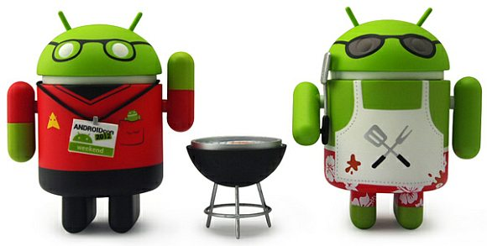
Android 101
Rabia Tugce Keser
Software Engineer, Zume Pizza Inc

Slide 2
Agenda
What is Android?
Material Design
Android Studio
Sample App - Movie App
Android Lifecycle
MVC
Layout Types
Listview - Adapter
Intent
Droidcon SF, 2017

Slide 3
What is Android?
It is an open-source operating system that is used primarily on mobile devices, such as cell phones and tablets.
It is a Linux kernel-based system that’s been equipped with rich components that allows developers to create and run apps that can perform both basic and advanced functions.
Android mobile applications can be developed in Java, C++ , Kotlin, Corona, HTML5, React Native etc..

Slide 4
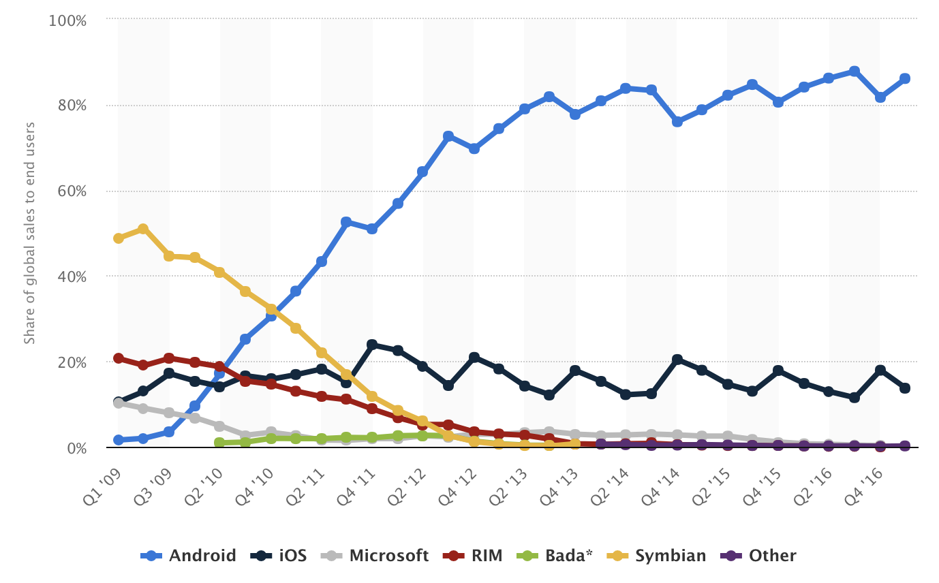
More than 2 Billion Monthly Active Android Devices!
Google Says There Are Now More Than 2 Billion Monthly Active Android Devices
Global mobile OS market share in sales to end users from 1st quarter 2009 to 1st quarter 2017
**https://www.statista.com/statistics/266136/global-market-share-held-by-smartphone-operating-systems/

Slide 5
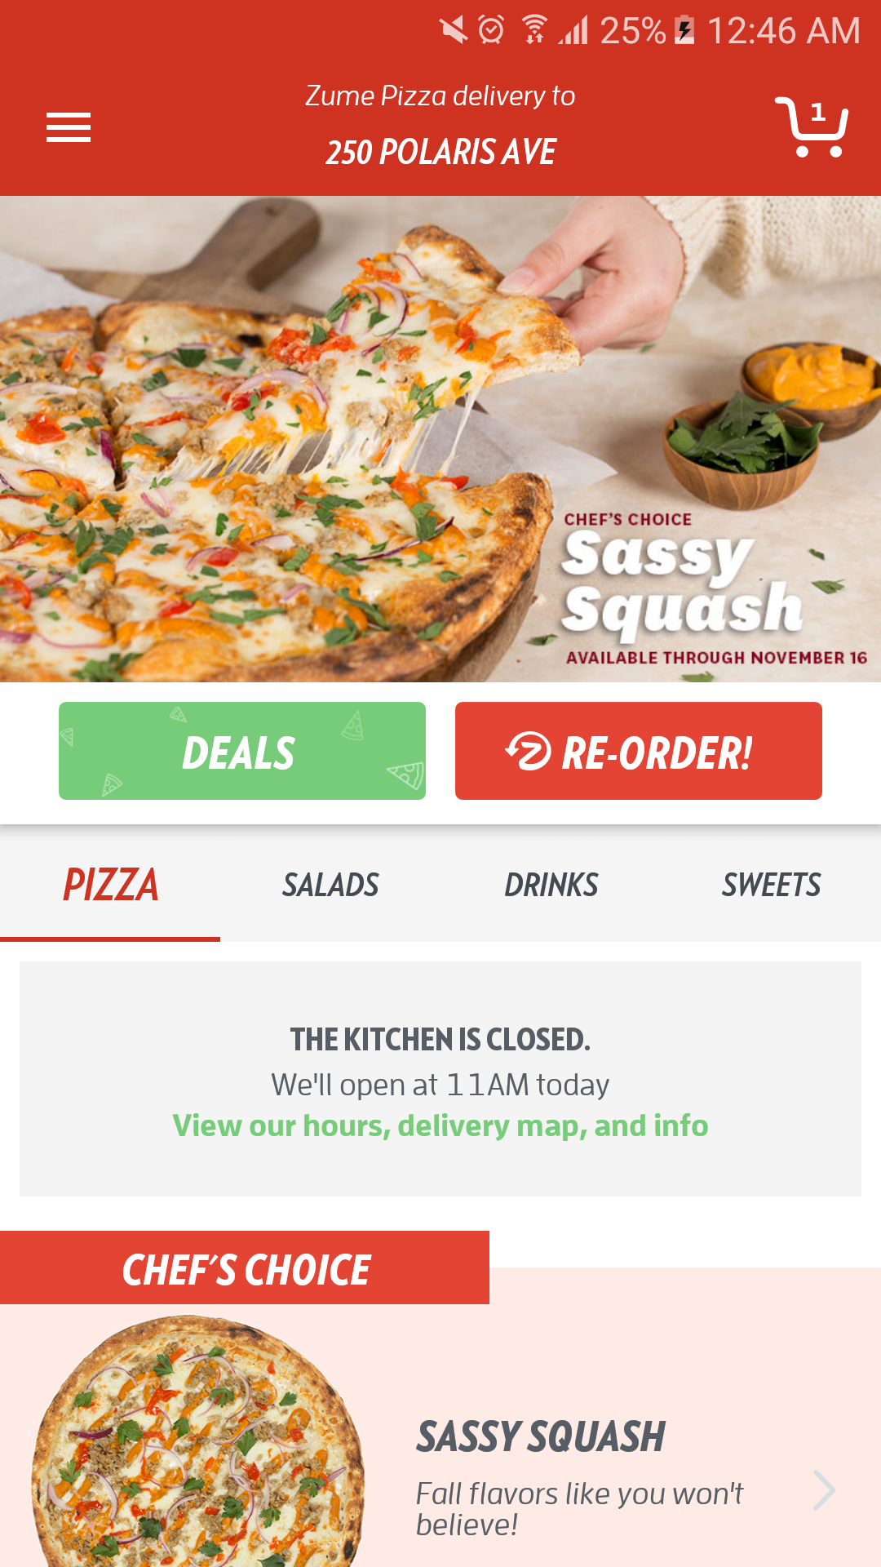
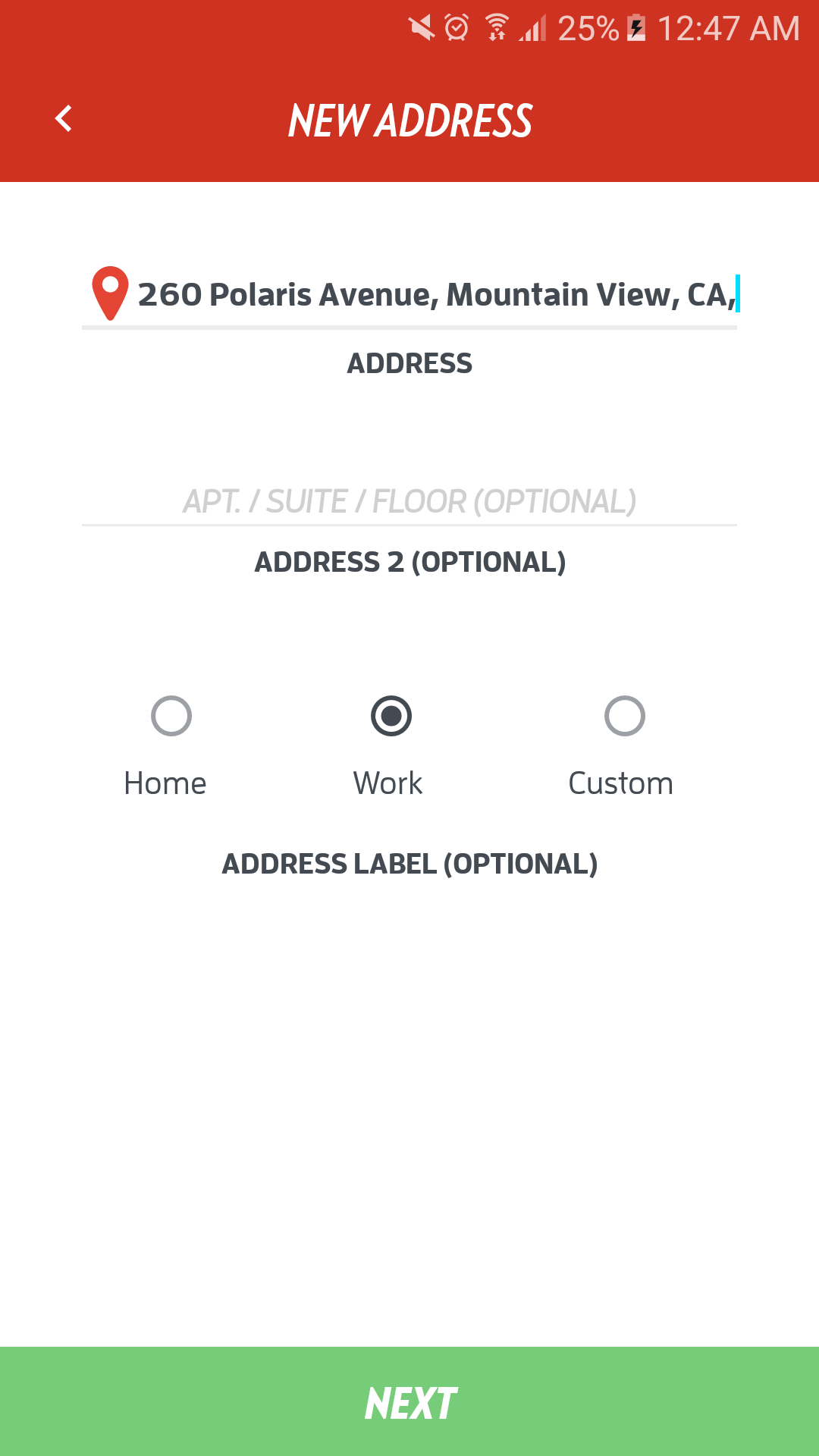
Material Design
Material design is a design language which is created by Google.

Slide 6
Android Studio
src - This is where all Java source files are located
lib - This is where third-party libraries are stored
res/layout - XML-defined view layouts
res/drawable - Place to store images
res/values - Strings, colors, etc.
assets - Place to store misc. static files (i.e text files)
gen - Automatically-generated, read-only code
AndroidManifest.xml - Application-wide settings

Slide 7
Cont...
AVD Manager: Creating and Managing virtual devices
SDK Manager: It is a command line tool that allows you to view, install, update, and uninstall packages for the Android SDK(Software Development Kit).
Project Structure: Project structure settings
Attach Debugger to Android App
Profile “app”

Slide 8
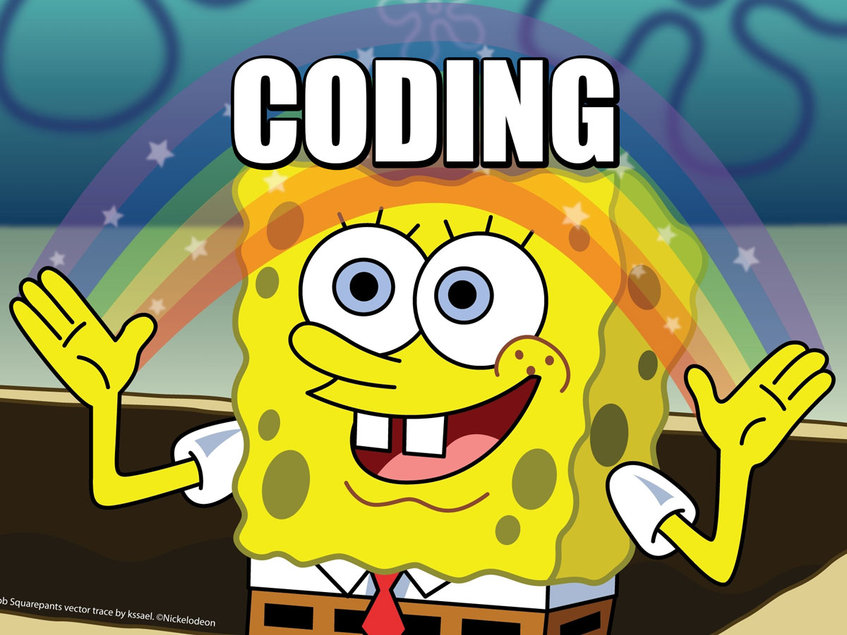
Let’s start to develop movie app!
Movie App

Slide 9
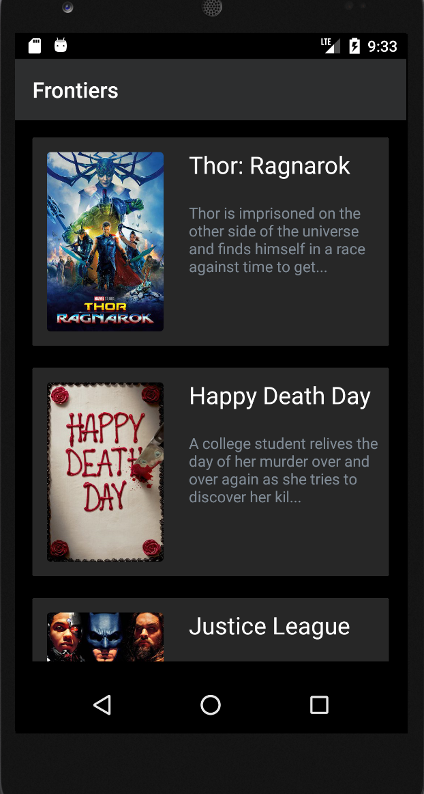
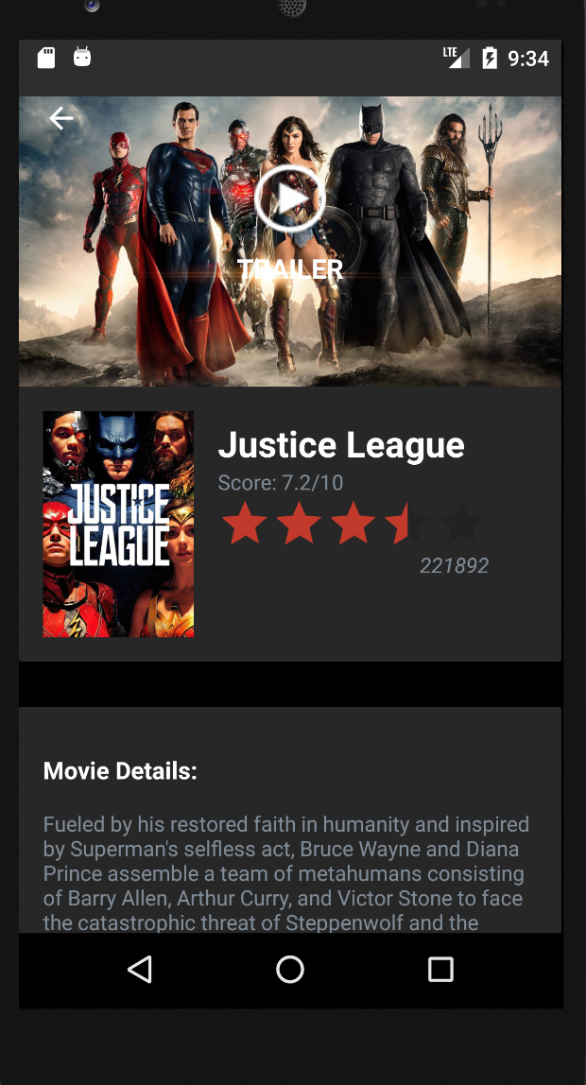

Movie App

Slide 10
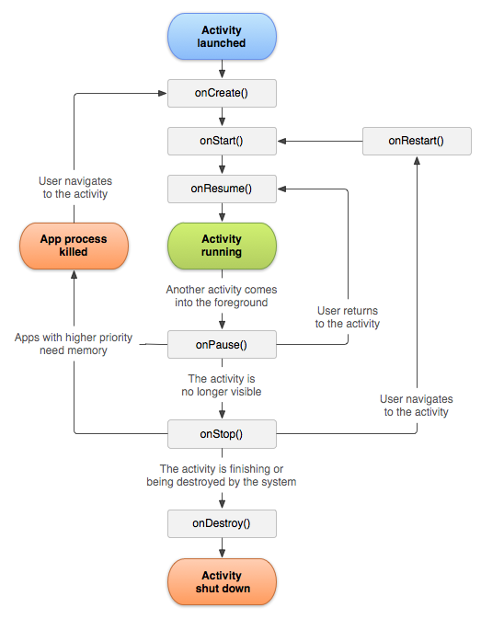
Activity Lifecycle
Android Life Cycle Video

Slide 11
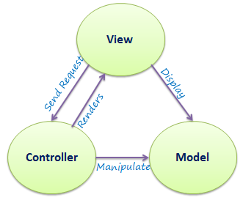
MVC (Model View Controller)
Model-View-Controller

Slide 12
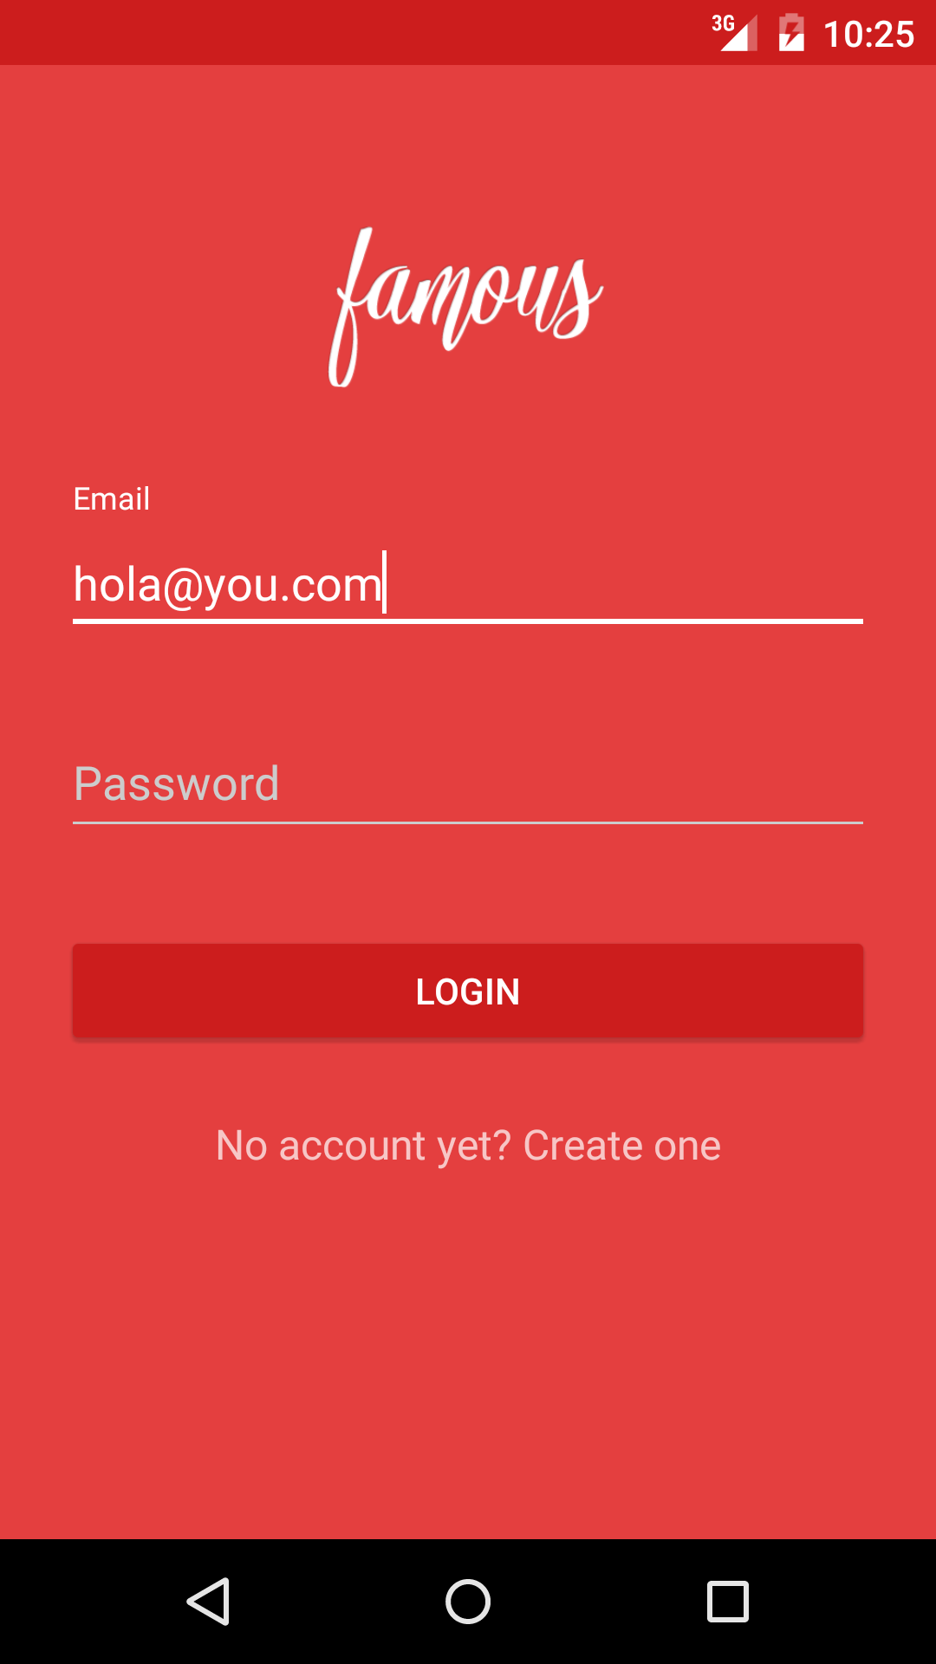
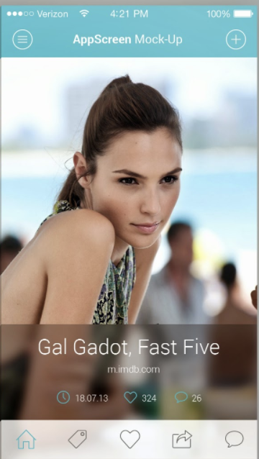
Layout Types
Relativelayout : RelativeLayout is a viewgroup that displays child views in relative positions
Linearlayout: LinearLayout is a view group that aligns all children in a single direction, vertically or horizontally. You can specify the layout direction with the android:orientation attribute.
https://www.tutorialspoint.com/android/android_user_interface_layouts.htm

Slide 13
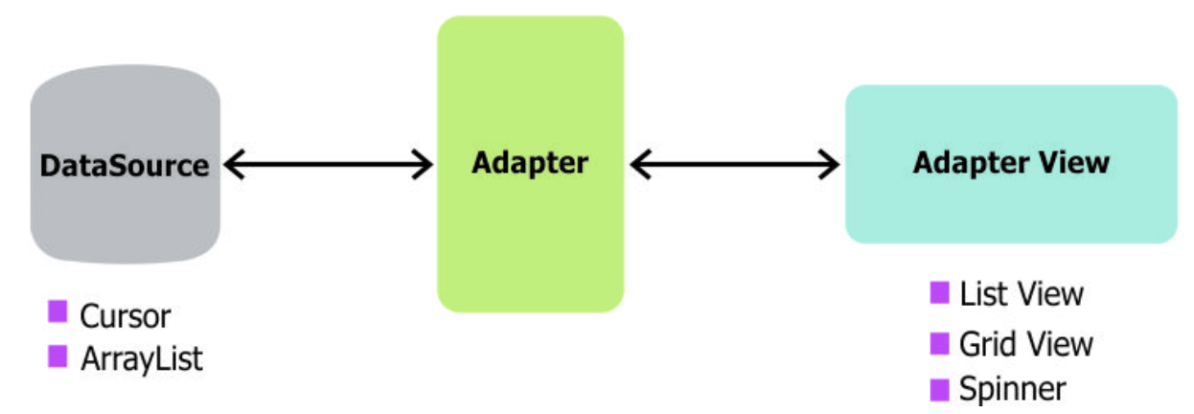
ListView - Adapter
ListView which has data populated using an Adapter

Slide 14

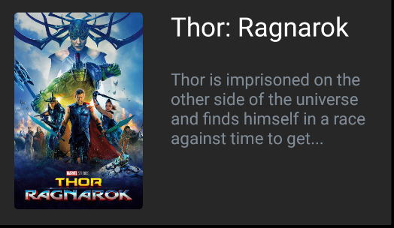
Cont...

Slide 15
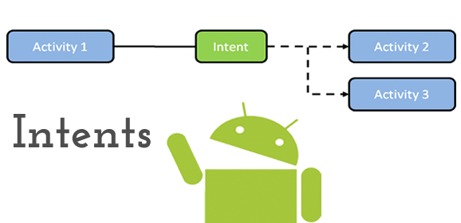
Intent
An intent is a message that can be thought of as a request that is given to either an activity within your own app, an external application, or a built-in Android service.
Explicit Intent : An "explicit" intent is used to launch other activities within your application.
Implicit Intent: This is in contrast to an explicit intent that targets a specific activity. For example, making a call, sending an email, launching a website

Slide 16
Optional Assignment:
Used RecyclerView instead of ListView
When viewing a popular movie (i.e. a movie voted for more than 5 stars) the video should show the full backdrop image as the layout. Uses Heterogenous ListViews or Heterogenous RecyclerView to show different layouts.
Allow video trailers to be played in full-screen using the YouTubePlayerView.
Overlay a play icon for videos that can be played.
More popular movies should start a separate activity that plays the video immediately.
Less popular videos rely on the detail page should show ratings and a YouTube preview.
Apply the popular Butterknife annotation library to reduce boilerplate code.
Apply rounded corners for the poster or background images using Picasso transformations
User can pull-to-refresh popular stream to get the latest movies.
Use Parcelable instead of Serializable using the popular Parceler library.
Replace Picasso with Glide for more efficient image rendering.
Leverages the popular GSON library to streamline the parsing of JSON data.
Leverages the Retrofit networking library to access the Movie Database API.

Slide 17
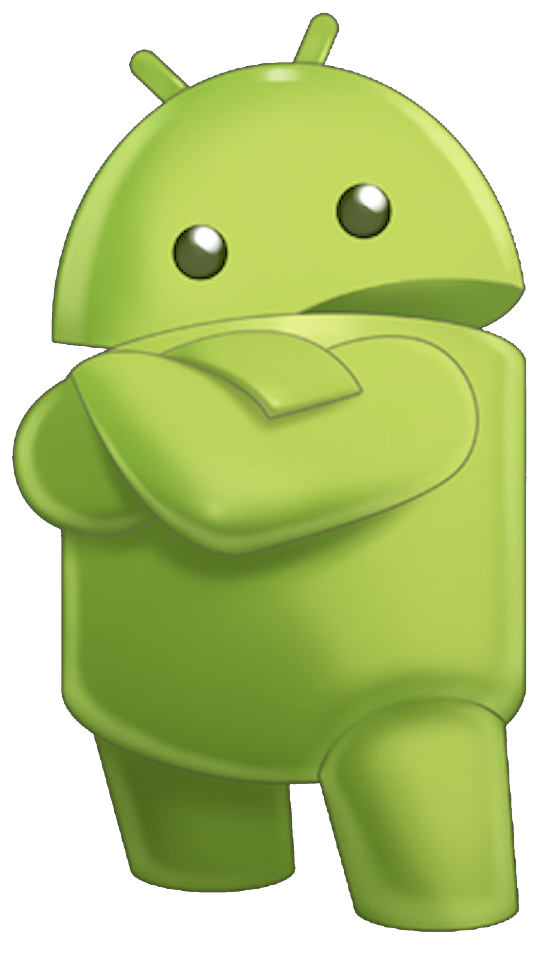
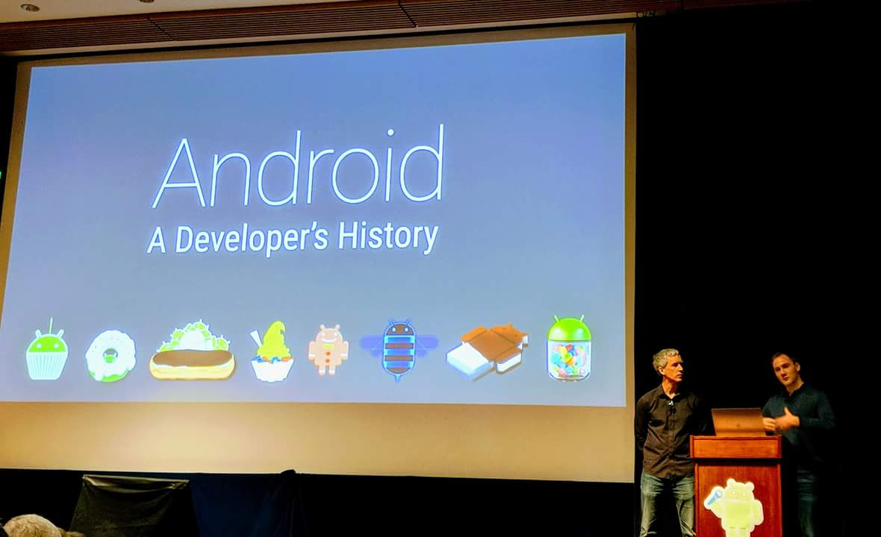
DroidCon SF, 2017

Slide 18
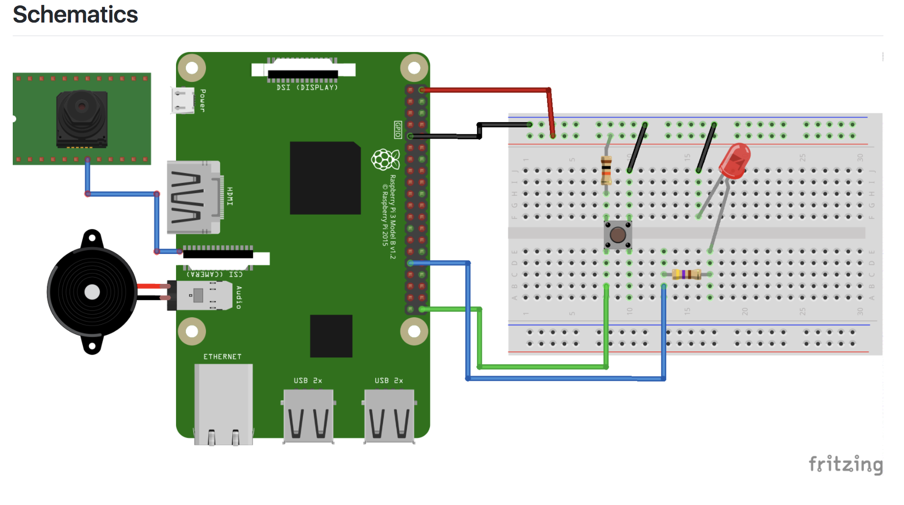
Android Things
Android Things lets you build professional, mass-market products on a trusted platform, without previous knowledge of embedded system design.
Sample Projects:
Sample Button (https://www.youtube.com/watch?v=Z-TDwr_Ba4o )
Tensor Flow Image Classifier
Weather Station (https://www.youtube.com/watch?v=2bVDK-q_ATo )
Starter Kit

Slide 19
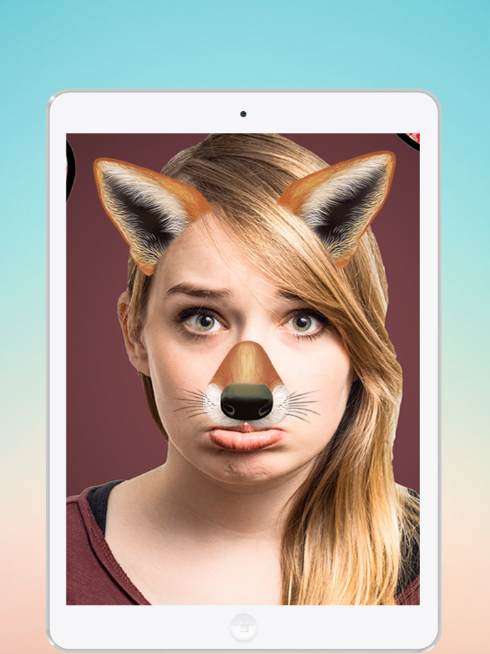
Square Libraries:
Kind-photo-bot
Snap activity / Printer Activity

Slide 20
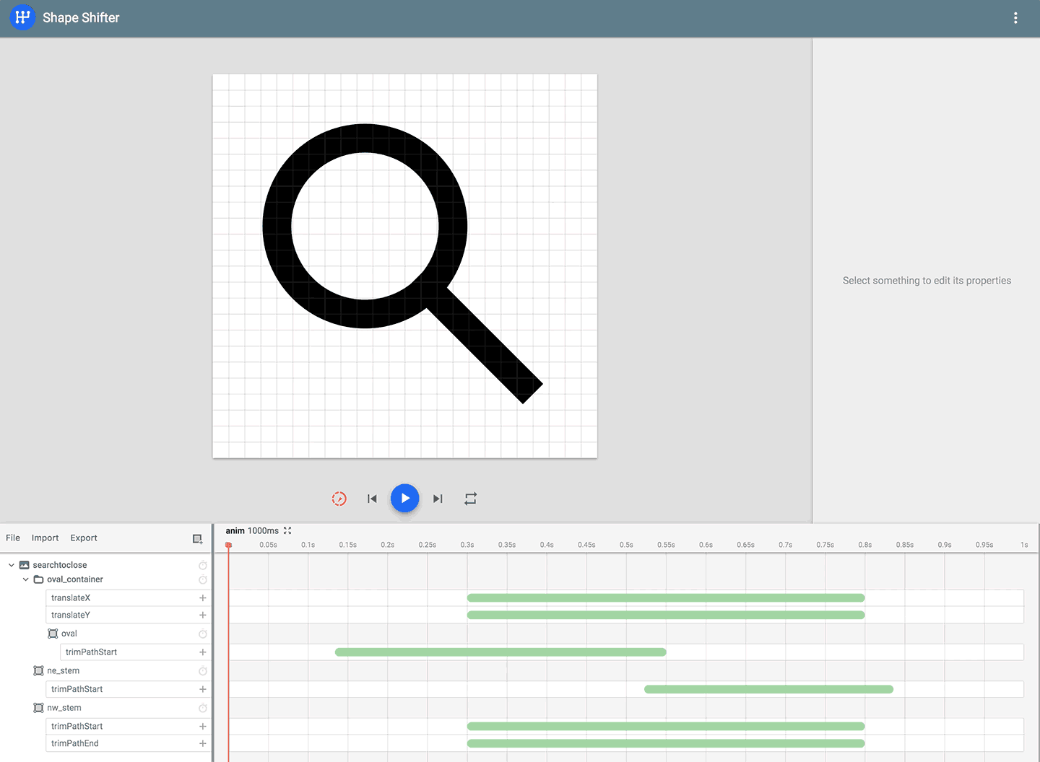

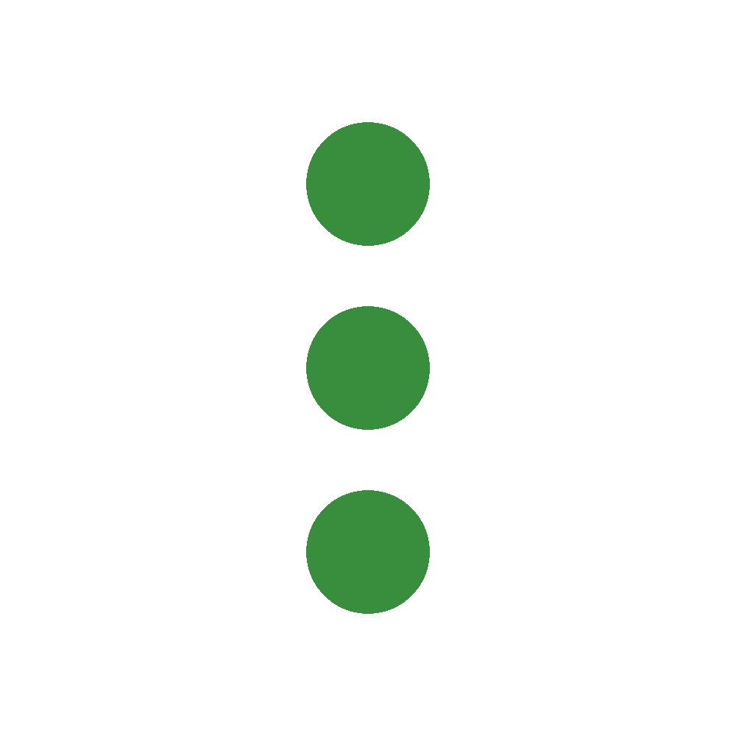

Shapeshifter
Shapeshifter is a SVG icon animation tool for Android, iOS, and the web

Slide 21
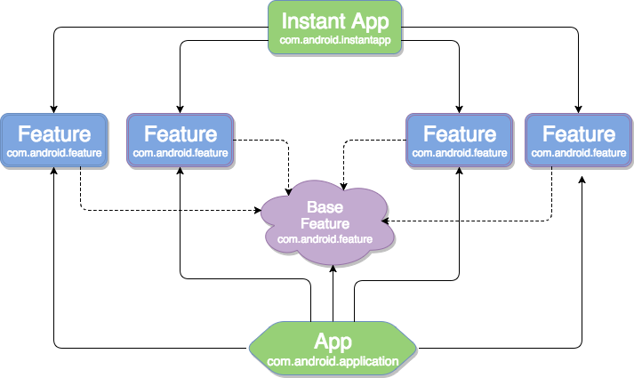
Instant app
Users can get to your flagship Android experience from any URL—including search, social media, messaging, and other deep links—without needing to install your app first.
When you request a certain feature from the instant app you are interested in, you will only receive the code that is necessary to run that specific feature. When you are done with the feature, the system will get rid of that code
https://www.youtube.com/watch?v=fanFGNPG7Dc&feature=youtu.be

Slide 22
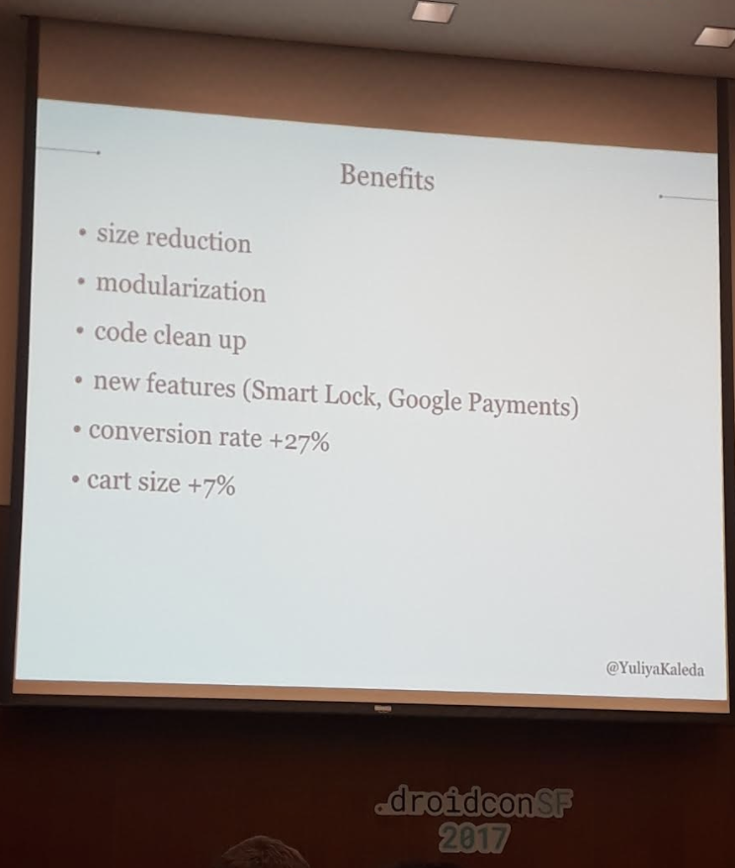
Jet - One of the first
Instant apps
Size Reduction
Modularization - Each module is max 4MB
Code cleanup
New Features (Smart Lock, Google Payments)
Conversion Rate +27%
Cart Size +7%

Slide 23
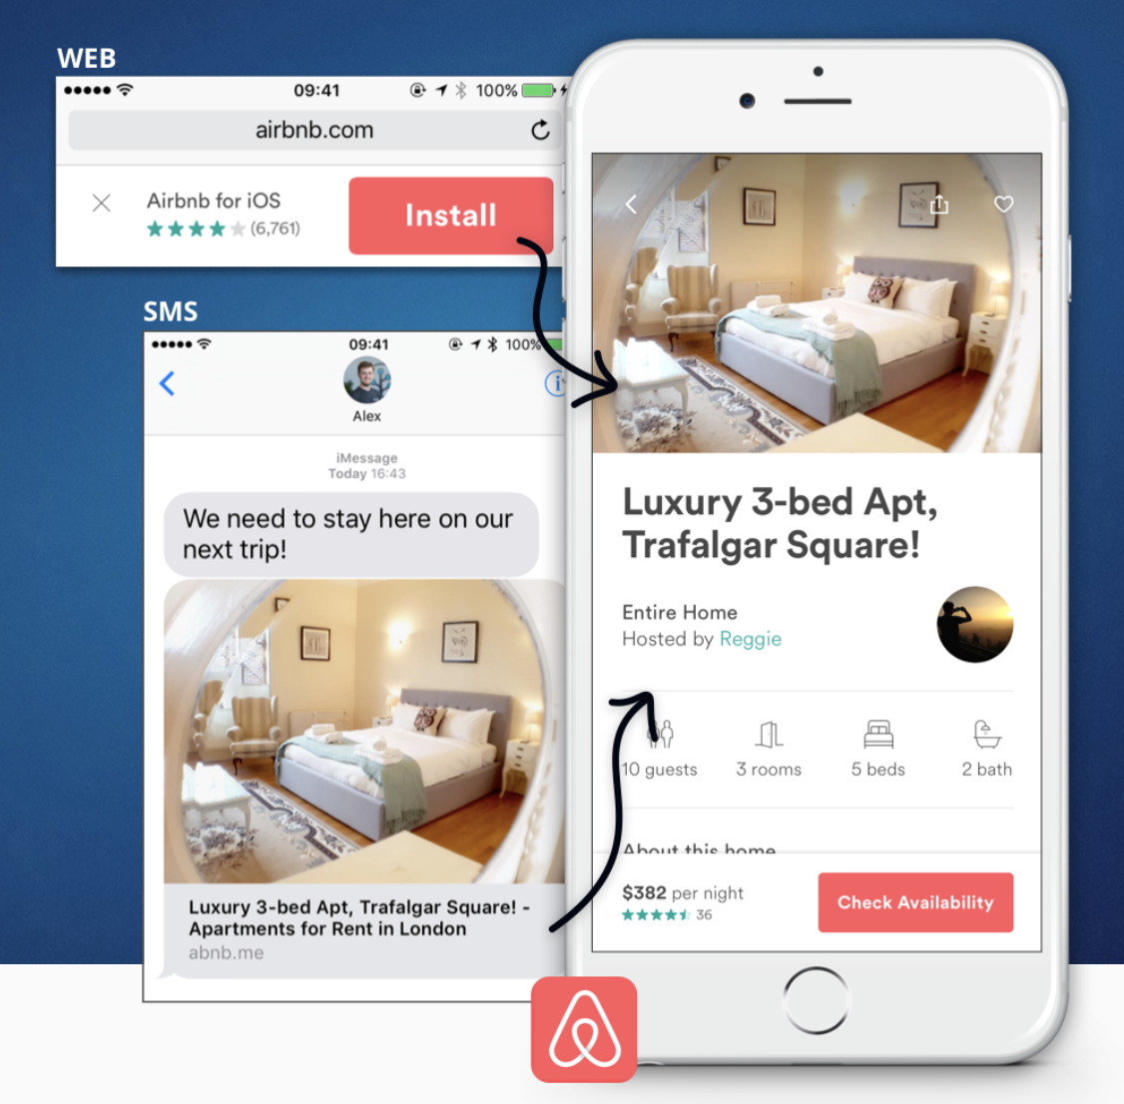
Branch
Branch increases mobile conversion, retention, and engagement through deep linking, user routing, and personalized app experiences.

Slide 24
